Slide 1
Epileptic Prediction
Using data from EEG
By Venkata R Bandaru

Slide 2
Dataset
The Dataset captures reading from EEG machine for 500 patients.
Each row in the dataset contains 178 attributes /independent variable.
Each attribute contains reading from the EEG data at specific time interval.
Each row contains a response variable.
The dataset can be found at here
Prediction on the dataset can be treated as a classification

Slide 3
Motivation for designing a classifier
The data represents reading from an EEG machine of brain activity.
Developing a classifier will help in evaluating if the patient is prone to seizures.
This classifier itself can be part of the EEG apparatus. This could help flag potential epileptic patients.

Slide 4
Approach
Perform Exploratory data analysis.
Perform Inferential statistics
Pre processing steps based on Data analysis.
Run classification algorithms
Identify the best classification algorithm
Create a webservice to make the model available

Slide 5
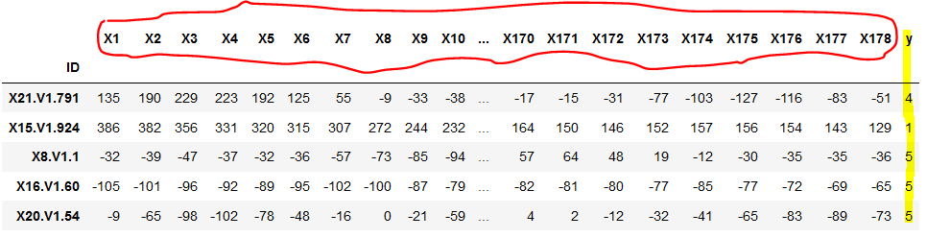
Exploratory Data Analysis - 1
Y is the response or dependent variable
X1..X178 are the readings from the EEG.

Slide 6
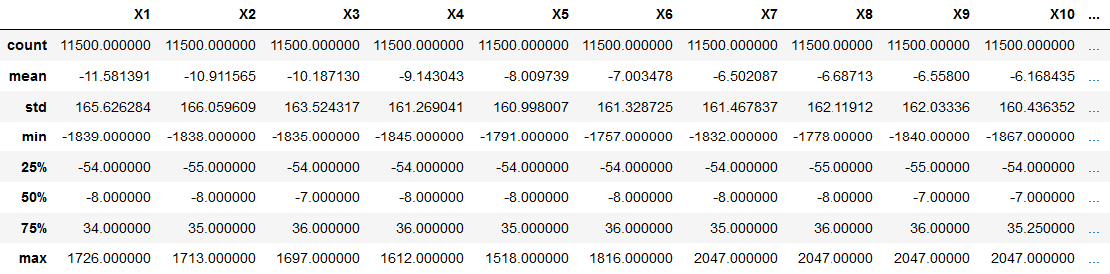
Exploratory Data Analysis - 2
A cursory glance at the Summary statistics shows
No missing values
There is no need to normalize the dataset, since all variables have the same scale.

Slide 7
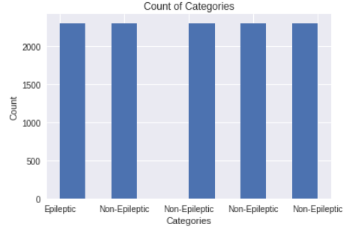
Exploratory Data Analysis - 3
There are 5 different labels/ Dependent variables.
Label 1 indicates an Epileptic patient. All other Labels indicate a Non Epileptic patient.
There is a class imbalance between the Epileptic and a Non Epileptic patient. We will handle this during the pre processing of the data.

Slide 8
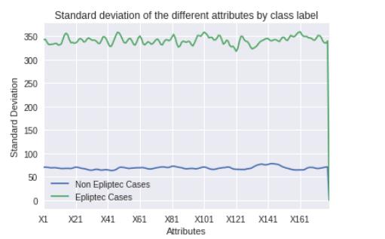
Exploratory Data Analysis - 4
It can be clearly seen that Epileptic cases (Y=1) have a high variation across all attributes

Slide 9
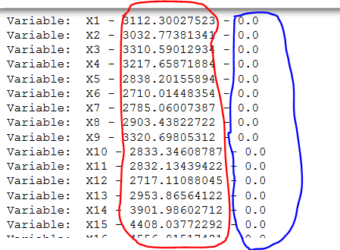
Inferential Statistics – Test for Normality -1
None of the variables are Normally distributed. The above is normal test . The High values (highlighted in red) and p value of 0 (highlighted in blue) indicate we can reject the null Hypothesis (The data is normally distributed)c

Slide 10
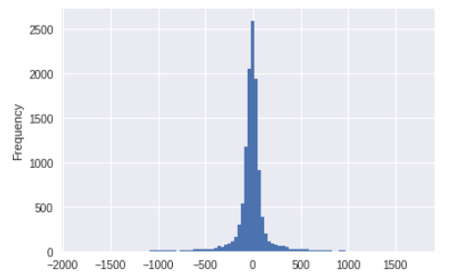
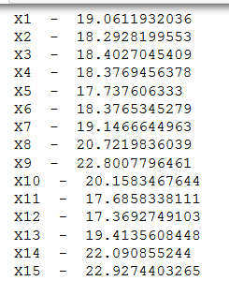
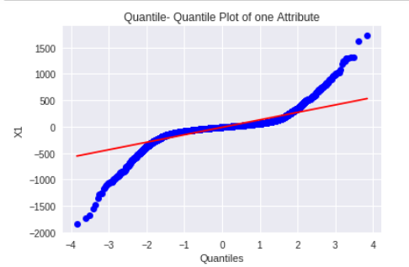
Inferential Statistics – Test for Normality -2
Plotting a Histogram for one of the attribute indicates that there is a high amount of kurtosis. This is highlighted by kurtosis value of 20 +.
The Q- Q plot on the far left also proves that the distribution of the variables are not normal.

Slide 11
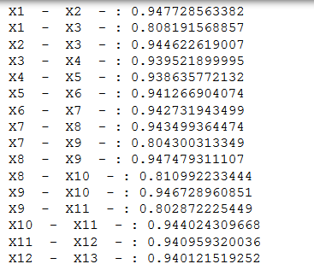
Inferential Statistics – Correlation
Variables are highly correlated with each other. We will have to handle this during the pre-processing step.

Slide 12
Pre processing the data - 1
Pre Processing steps include
PCA to reduce the number of attributes and eliminate correlated variables
Remove class imbalance

Slide 13
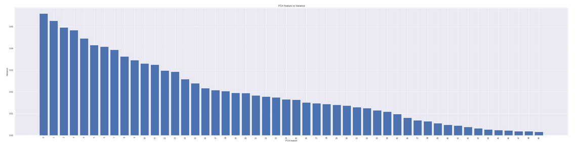
Pre processing the data – PCA
The Y axis indicates the Variance. X indicates the number of components. The value tapers down at about 80 components.

Slide 14
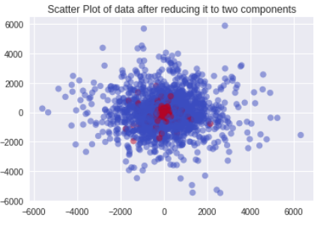
Plot of two components derived using PCA
Blue does indicate non epileptic patients. Red indicates epileptic patients.

Slide 15
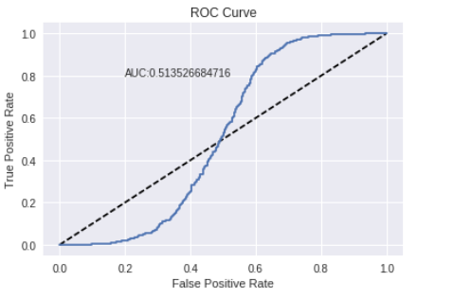
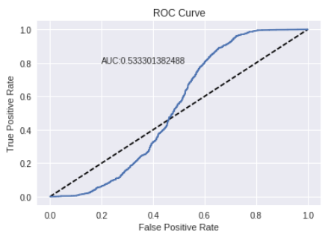
Classification Algorithms Logistic Regression
ROC Curve using Logistic regression without any preprocessing step. The AUC value is 0.51
ROC Curve using Logistic regression with preprocessing step. The AUC value is 0.53

Slide 16
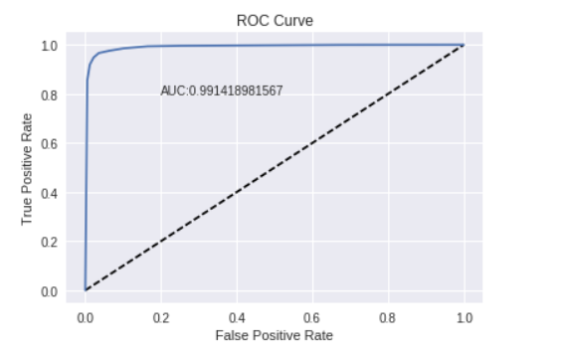
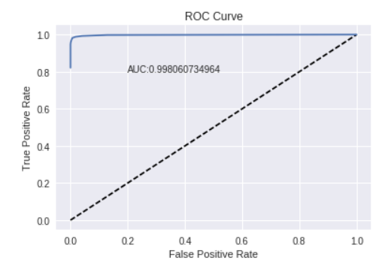
Classification Algorithms Random Forest
ROC Curve using Random forest before and after Pre-Processing and after . There is an increase in the AUC value from 0991 to 0.998

Slide 17
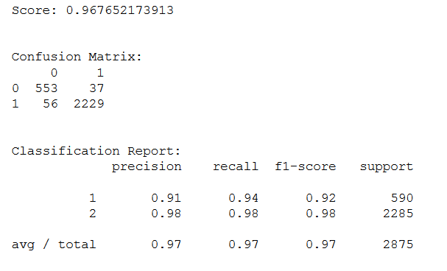
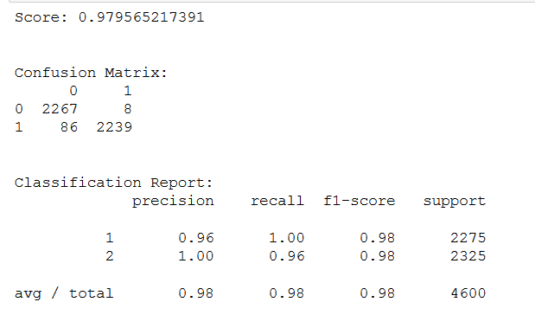
Classification Algorithms Random Forest
Accuracy, Precision , Recall before and after pre-processing. There is a improvement in the values post processing.

Slide 18
Conclusion
Random forest model was a far better predictor than the Logistic regression classifier.
The is due to the fact that there is no clear boundary separating the classes (Slide 14).
Normalization of the data was not needed since the attributes were distributed in a similar manner (Slide 6).
Reducing the number of attributes using PCA and Oversampling the classes which were uneven helped in increasing the accuracy metric.

Slide 19
Create a webservice
The Model was exported using pickle.
Using Python Flask module and gunicorn http webserver the model was exposed through a webservice.
A web page to input the values was created.

Slide 20
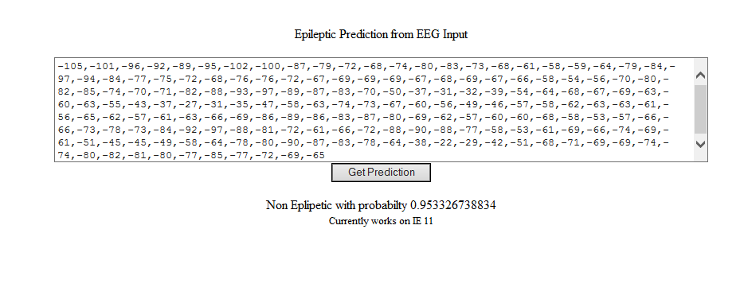
Web interface to call the model

Slide 21
Credits
Many thanks to my mentor Amir Ziai
Thanks to UCI for hosting the Dataset
Thanks to the authors of the Dataset (Andrzejak RG, Lehnertz K, Rieke C, Mormann F, David P, Elger CE (2001) Indications of nonlinear deterministic and finite dimensional structures in time series of brain electrical activity: Dependence on recording region and brain state, Phys. Rev. E, 64, 061907)

